Slide 1
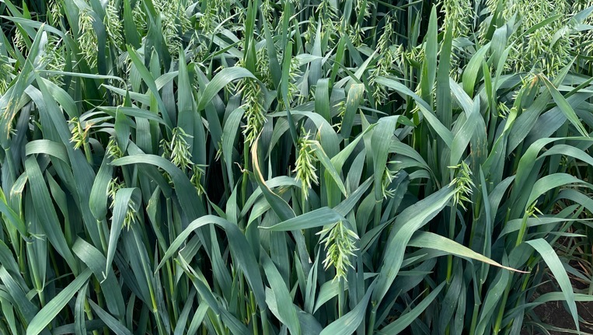


International Fodder Oats Network (IFON)
Breeding oats for environmental and social change
E. John Stevens¹, V. Hajdarpasić², A. Russell³, J. Jović², K. Armstrong⁴, D. Mandić², S. Kikić², M. Andreucci⁵, J. Hampton⁵
¹ Flexiseeder Ltd. New Zealand (NZ);
²SEMEC, Bosnia & Herzegovina (BiH);
³Plant Research (NZ) Ltd;
⁴Global Oats (NZ)Ltd;
⁵Lincoln University (NZ)

Slide 2

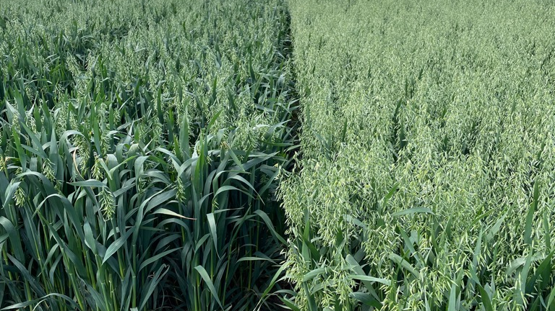
Introduction (Adrian Russell)
ctrl+click the URL to view video
https://www.youtube.com/watch?v=x0QrAG_QMp8
Our work
Goals

Slide 3
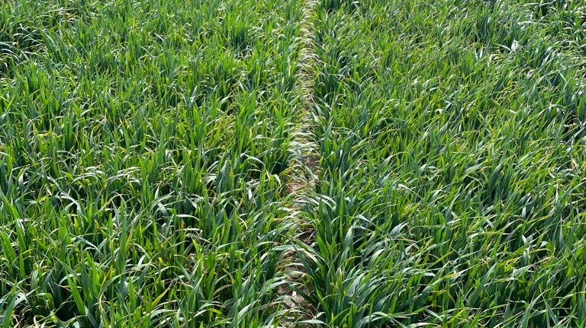
Key points
Social enterprise open to public and private sector
New members expected to add germplasm
Scope for the inclusion of ryecorn, triticale and companion crops
Other countries welcome (dependent on $ support)

Slide 4
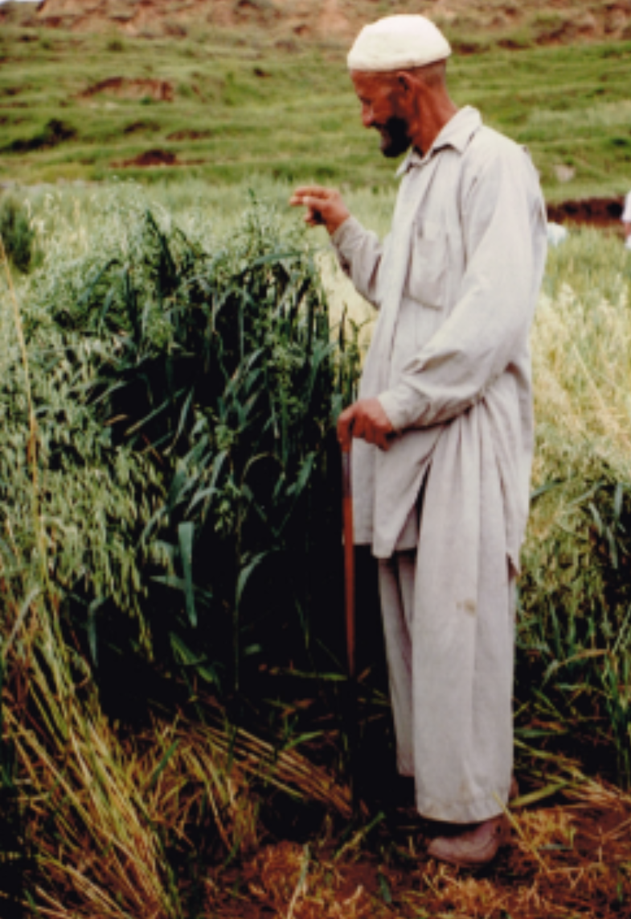
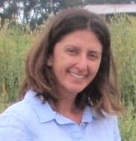
Background
Shuttle breeding started in the 50s and reached Himalayan Hindu Kush in 1979/80
Initiative started with NZ – Canada
Broad adaptation of cvs characterised global potential of the initiative
Potential to increase food security, climatic resilience and pave the way to social change
CV: NZ Makuru
Azad Kashmir, 1979-80

Slide 5
Experience: Nepal 1980 – 2000
Built on outcomes from NZ – Canada – Peru – Pakistan initiatives
Bulk importation of seed and distribution throughout the country led by farmers
Included livestock and agronomy support
Used spring and facultative types but also highlighted the importance of winter material as genetic background
Khimti Nepal 1980s, 5 days walk home, CV NZ Makuru

Slide 6
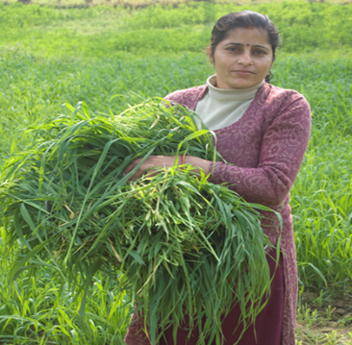
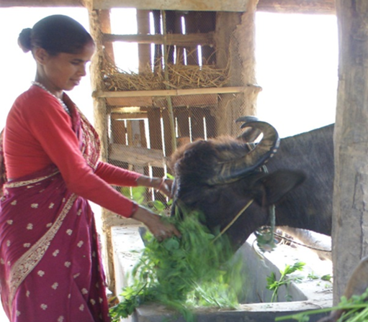
Experience: Nepal 2000 – 2019
Ongoing collaboration: materials are sent from NZ and selected in country across a range of altitudes
Equipment like single head threshers are provided and selected varieties released
Farmers and commercial seed enterprises were established
Springboard for the Balkans and IFON initiatives

Slide 7
Current spread of NZ fodder oat genetics
Spring sowing: high latitude & continental
Spring & autumn sowing: lowlands
Highland spring and lowland autumn planting in tropics & sub-tropics
Spring & autumn sowing
Shuttle breeding allows more than 1 generation/year across a wide range of environments

Slide 8
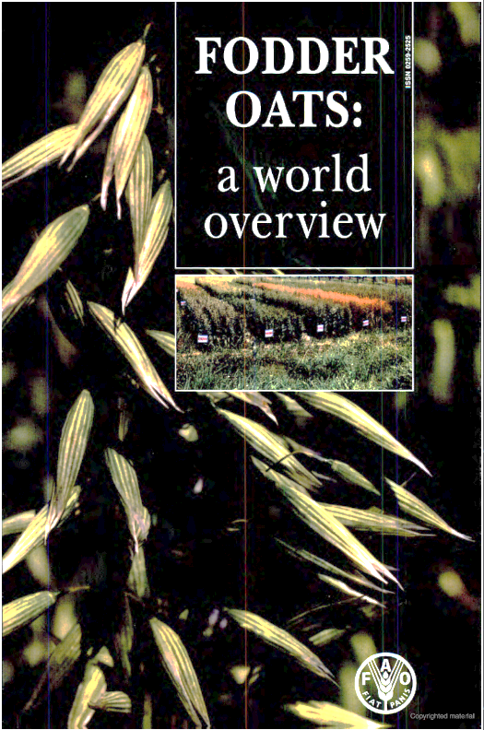
Balkans 2020 – 2022
Need for the strategy was identified in the 1990s
Philanthropic assistance requested in 2020: start a Balkan fodder improvement network for impoverished and food insecure families (catalyst being Covid-19 pandemic)
NZ genotypes work as a starting pool of genetic resource
Network will be based on FAO overview and the Nepalese model

Slide 9
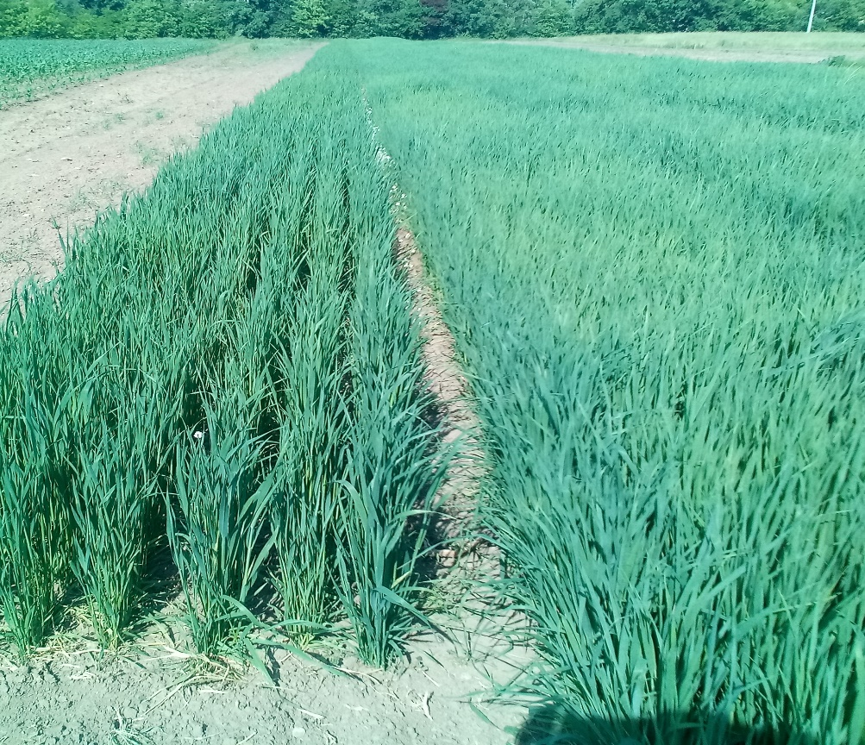
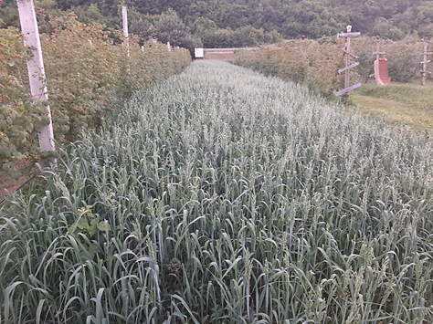
Balkans: start as a self funded initiative
Philanthropic provision of NZ seeds that were planted in 2021 and 2022
Grown in a BiH research station and across 6 farms, with an altitude range from 450 to 800 m
‘Sana’
NZ cv.
Comparisons against local varieties (‘Sana’) and selection are being done
Flexiseeder machinery technologies endowed
NZ cv.

Slide 10
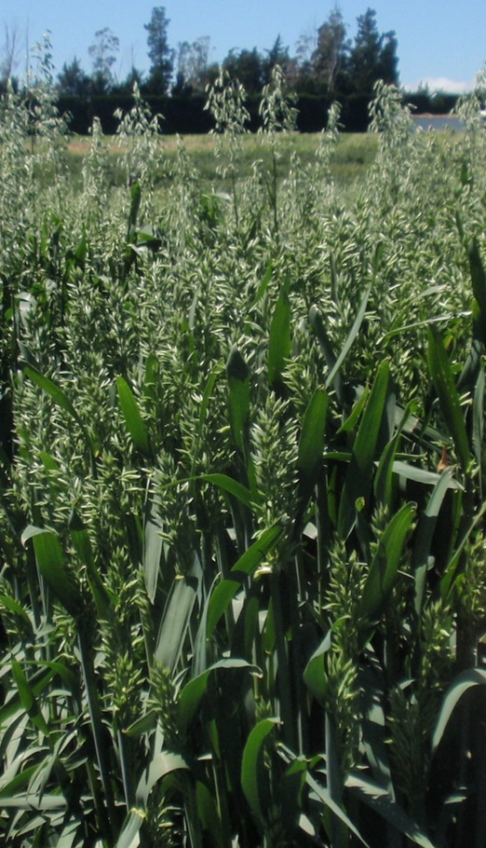
Balkans: current progress
Other 39 NZ lines were donated and sowed in NZ in 2021. These were selected for specific phenological and leaf traits
Selected lines were planted during spring 2022 in the Balkans
450 lines endowed from the Banja Luka Institute (BiH) gene bank were sent to the James Hutton Institute (Scotland) to be multiplied. Samples of 250 harvested & being sent to NZ

Slide 11
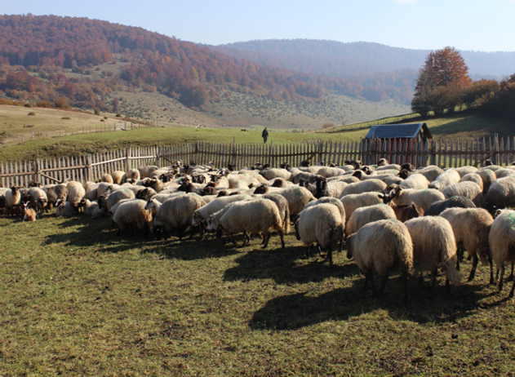
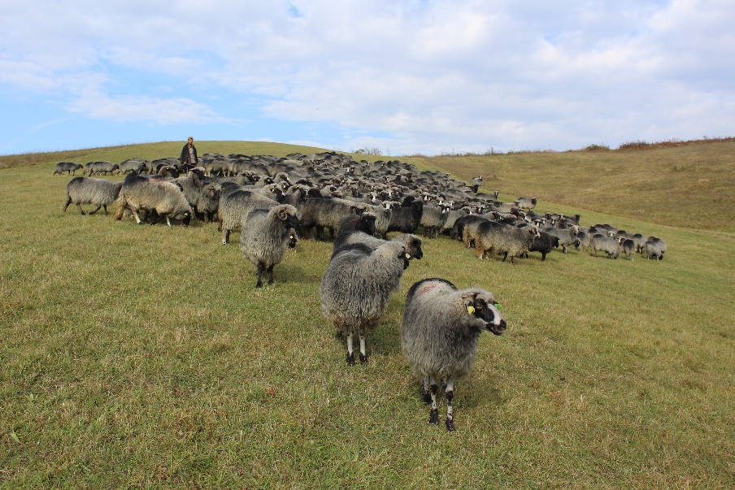
Balkans: next steps
Croatia has joined IFON and Turkey has initiated the process. Other Baltic and near-by states also interested
Process of funding application has started (European funding opportunities)

Slide 12
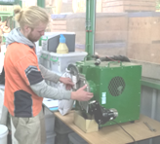

IFON framework
IFON coordination and facilitation
Humanitarian assistance and climate resilience
Breeding and gene bank support
Agronomical research support
Machinery and technologies
Industry, harvesting and processing
Seed (tech., cert., PVRs)
Livestock integration
International nurseries and material transfer

